Slide 1
CSB REDUX
Eligibility and Process
SSG Anthony Barton
HRO-AGR

Slide 2
Agenda
Types of Retired Pay Systems
Impact of REDUX on Retired Pay
Career Status Bonus
CSB Election Process

Slide 3
Types of Retired Pay Systems
Final Base Pay = joined prior to 8 Sep 80
High Three = joined between 8 Sep 80 – 31 Jul 86
CSB/REDUX = joined on 1 Aug 86 or after
Creditable status includes:
DEP, ROTC, Military Academy, and Health Professions
Scholarship Program

Slide 4
Final Base Pay Formula DIEMS is prior to 8 Sep 80
Years of Service x 2.5% x final base pay = $ Retired Pay
Retired pay is calculated against the amount of the base pay at retirement
Multiplier is 2.5% per year of active service plus 1405 time
COLA is at full rate as determined by the Consumer Price Index

Slide 5
High Three Average Formula DIEMS is between 8 Sep 80 – 31 Jul 86 Or AGR member eligible for REDUX declined the Career Status Bonus
Years of Service x 2.5% x average 36 mo base pay = $ Retired Pay
Retired pay is calculated against the average of the member’s highest 36 months of base pay
Multiplier is 2.5% per year of active service plus 1405 time
COLA is at full rate as determined by the Consumer Price Index

Slide 6
REDUX Formula DIEMS is 1 Aug 86 or later
AGR member accepted the Career Status Bonus ($30,000) at 15 years of active service
• Retired pay is calculated against the average of the member’s
highest 36 months of base pay
• Multiplier is based on:
First 20 years multiplied by 2.0%
Each year after 20 until 30 multiplied by 3.5%
Reverts to 2.5% after 30 years
• COLA is 1% less than the full rate as determined by the Consumer Price Index
One time catch up at age 62

Slide 7
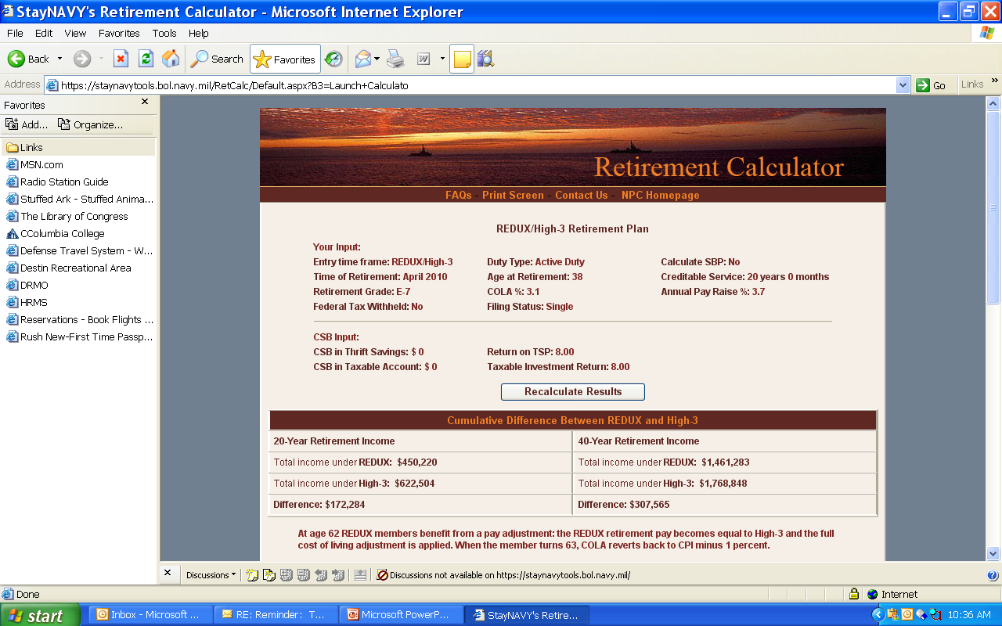
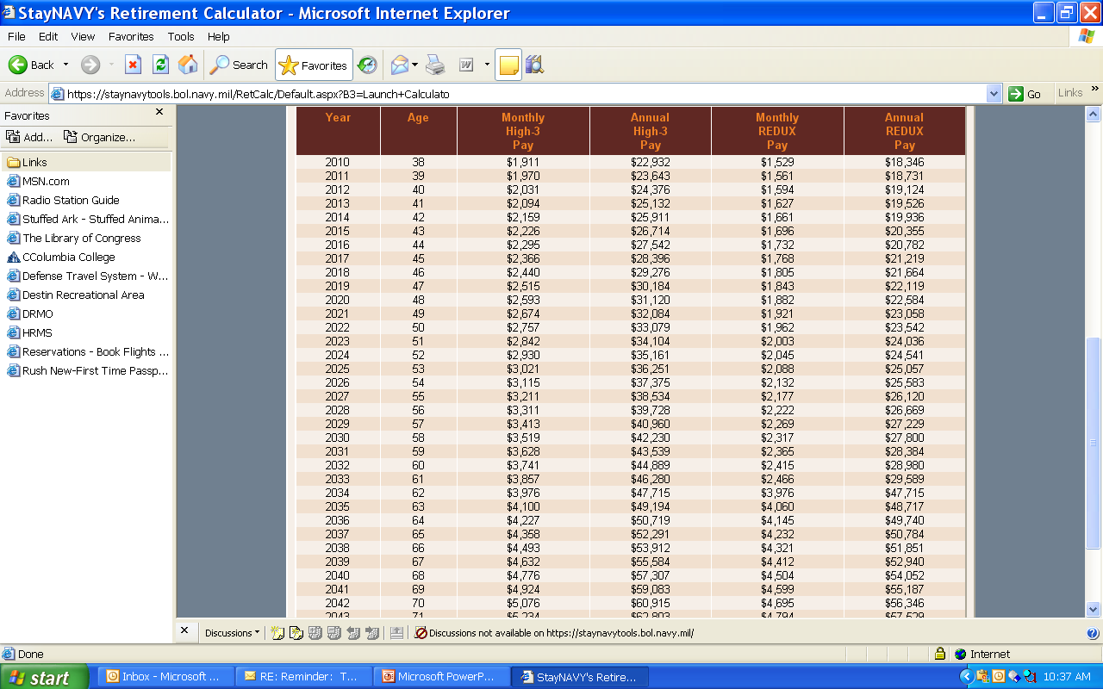
Impact of REDUX on Retired Pay
Based on E7 with 20 years active service
Notes:
This screen is applicable to those soldiers who will be retiring under the REDUX program. It lists the two different payment options until the year 2050.
Notice that at age 62 the REDUX is adjusted to match the High Three. Then it once again starts depreciating.

Slide 8
CSB (Career Status Bonus)
AGR members whose DIEMS is 1 August 1986 or later are eligible for a one time $30,000 bonus at their 15th year of active service.
Bonus can be taken as lump sum or up to five annual payments.
Money can be transferred to TSP (with limitations)
No restrictions on what is done with money.
Money is Taxable in most cases!
If the bonus is accepted, the AGR member is agreeing to serve at least 20 years active service
If separated from active service, except for medical disability, prior to 20 years the bonus will be recouped

Slide 9
CSB - Continued
If CSB is accepted, the AGR member is agreeing to fall into the REDUX category for retirement.
If the CSB is declined, the AGR member will revert to High 3 retirement system.
AGR members should be counseled at 14 ½ years on the CSB/REDUX program.
DD 2839 recording the member’s election to receive or decline the bonus should be placed in IPERMs and retained in local AGR files.
DD 2839 must be sent to the Transition Center at the time of the member’s retirement.

Slide 10
CSB Election Process
DD 2839 preparation
Block 1-3 Service Member info
Block 4 Date Initially Entered Military Service (DIEMS)
Block 5 – Basic Active Service Date (BASD)
Block 6 – Make this date the day the form is signed.
Block 7 – Check eligible to receive

Slide 11
CSB Election Process
Block 8 date should be same as Block 6 date
Block 9 Signature by O5 or higher.
Soldier completes Section IV or V to accept or decline the bonus. Make dates match block 6.
Section VI – make dates match block 6.
Recommend witness be O5 or higher.
Give soldier copy and make sure one is sent to personnel and pay.

Slide 12
Top Three Take Aways
Cola for REDUX retired pay is 1% less than the full rate.
The CSB is taxable in most cases.
Consult a financial planner before making your CSB/REDUX election!

