Slide 1
PRE-TEST
2025 Joint Annual
Sexual Assault Prevention
and Response Training

Slide 2
Definitions & Concepts
Consent
Sexual Assault & Sexual Harassment
Restricted Report & Unrestricted Report
Expanded Restricted Report
Victim Rights
Leadership Roles & Responsibilities
Bystander Intervention
SAPR services
Notes:
Consent:
freely given agreement
competent person
Age - adult
Sexual assault:
intentional sexual contact
use of force, threats, intimidation, or abuse of authority
when the victim does not or cannot consent.
rape, sexual assault, aggravated sexual contact, abusive sexual contact, forcible sodomy, or attempts to commit these acts.
Sexual harassment
unwelcome sexual advances
requests for sexual favors
deliberate or repeated offensive comments or gestures of a sexual nature.
Expanded Restricted
file a Restricted report, even if the victim discloses to a mandated reporter.
Mandated reporter still required to contact law enforcement.
The only exceptions are if the victim has disclosed DIRECTLY to law enforcement
or has previously made an Unrestricted Report for the same incident.
Victims Rights
Victims have rights throughout the process, including the right to….
• Fairness and respect.
• Maintain a degree of privileged/protected communications.
• Protection from alleged offender.
• Preference between military and civilian prosecution.
• Input to authorities overseeing case.
• Notice of proceeding events.
• Heard at certain proceedings.
• Confer with prosecution.
• Receive restitution as provided by law.
• Proceedings free from unreasonable delay.
Leadership’s role and responsibilities
Provide support within the workplace.
• Ensure victim’s rights are protected.
• Ensure the victim’s physical safety, emotional security, and medical treatment needs are met.
• Notify the Commander/Director of any barriers to support.
• Protect from retaliation.
SAPR services
Advocacy
Medical/mental health care
Facilitate SAFE exam, if neededa
SVC
CATCH
Link to community resources

Slide 3
Private (PVT) Acevolt
Airman First Class (A1C) Lionhart
PVT Acevolt is faced with “locker room” behavior from a fellow student at the Regional Training Institute. The behavior isn’t addressed and progresses to an assault. The story emphasizes the impacts of assault on a male survivor and how the class climate can be affected.
A1C Lionhart is drugged and assaulted by an unknown perpetrator. The story walks through the trauma faced by a victim and the choices they are given. It emphasizes available resources such as a Military Protection Order.

Slide 4
Airman First Class Lionhart
During a social outing after Annual Training, A1C Lionhart starts to experience nausea and a headache after a few drinks.
Lionhart goes to get some water. The next thing she remembers is waking up in the middle of the street, some time during the night. Her shirt is ripped, and her pants are down around her knees.
Lionhart calls her friend, Fireborne, for a ride. Fireborne states that during the outing, she assumed Lionhart had gone home due to her headache.
Lionhart recalls that she only had two drinks before feeling terrible. Fireborne and Lionhart decide that she was probably drugged. Fireborne believes A1C Lionhart should go to the hospital. Lionhart agrees. Fireborne also encourages Lionhart to call the Safe Helpline. Through the Helpline, Lionhart gets contact information for a local Victim Advocate.
Lionhart goes to the hospital. The medical team draws labs right away. A nurse asks Lionhart if she feels like she was assaulted. Lionhart is having trouble thinking clearly.
The Victim Advocate, Dragonia arrives at the hospital. She first establishes that everything discussed between them is confidential. She says that if Lionhart wants, a specially trained Sexual Assault Nurse Examiner (SANE) can perform a Sexual Assault Forensic Examination (SAFE). She explains that the nurse will typically ask about details of the assault to identify potential areas for injuries and may also collect Lionhart’s clothing, as there may be DNA evidence on them. The nurse would then do a head-to-toe exam, collect samples where there may be DNA, and take pictures of any injuries sustained. The nurse could also provide preventative treatment for possible sexually transmitted infections and pregnancy prevention.

Slide 5
Airman First Class Lionhart (continued)
Dragonia talks to Lionhart about the basics of the Sexual Assault Prevention and Response program and the reporting options. She explains that with a Restricted Report, everything remains confidential. She tells Lionhart about the resources available, such as medical and mental health care, Special Victims’ Counsel, and a Line of Duty (LOD) determination.
Dragonia explains that with an Unrestricted Report, Lionhart’s Commander and law enforcement would be notified. The resources would be the same as with a Restricted Report, but Lionhart could also get an Expedited Transfer, and/or Military and Civilian Protective Orders.
CHOICE 1:
Restricted Report
Unrestricted Report

Slide 7
Airman First Class Lionhart (continued)
Lionhart chooses the Restricted Report option. Dragonia explains that it will remain confidential, and Command won’t find out. Lionhart can utilize many military and civilian resources, including mental health providers, Chaplain services, and Special Victims’ Counsel (SVC). Dragonia says that meeting with SVC often provides victims with information to help them make legal decisions.
Dragonia also tells Lionhart about the CATCH program, a database that interfaces with law enforcement systems and allows the victim to enter information about their perpetrator. If more than one victim reports the same perpetrator, a match will be generated. Victims are then asked if they’d like to pursue an investigation.
Lionhart has had trouble sleeping since the assault and is scared to leave her house alone. Her parents have been taking turns staying with her, and Fireborne checks in with her all the time.
CHOICE 2:
Victim Advocate
Special Victims’ Counsel

Slide 8
Airman First Class Lionhart (continued)
After three weeks, Lionhart feels like her fear, nervousness, and nightmares are getting worse. She calls Dragonia, who helps her set up some appointments.
Lionhart tells Dragonia that she has been struggling with not knowing what happened. Dragonia helps her realize that these are normal reactions to the trauma experienced.
Lionhart is considering changing her report to an Unrestricted Report, but she would like to know what it entails. Dragonia explains that law enforcement and Lionhart’s Command team would be contacted. Law enforcement would conduct a full investigation, but Dragonia explains that Lionhart has the choice on whether she wants to participate in the investigation.
CHOICE 3:
Keep Restricted Report
Convert to Unrestricted Report

Slide 9
Airman First Class Lionhart (continued)
Lionhart elects to keep it Restricted, as she isn’t sure she wants her Commander to know. Lionhart is coming up for a promotion soon and worries about them doubting her stability as a leader.
As time passes, Lionhart decides to call a behavioral health provider who helps her talk through her experience and teaches her some techniques to manage anxiety. She listens, provides Lionhart with civilian resources, and they set up more appointments.
Eventually, Lionhart decides to convert to an Unrestricted Report. She meets with Dragonia to convert her original DD Form 2910 from Restricted to Unrestricted. Dragonia contacts the Sexual Assault Response Coordinator (SARC), who contacts Lionhart’s Commander with information about the case.
Lionhart’s Commander calls right away to express support. He tells her that he is required to report the situation to law enforcement. If the criminal investigative agency declines to investigate, he can ask The Adjutant General to request that the National Guard Bureau’s Office of Complex Investigations conduct an administrative investigation, since the report is unrestricted.
Lionhart’s Commander explains that it is her choice whether she wants to participate in an investigation. He clarifies that an investigation can still be conducted without her involvement.

Slide 10
Airman First Class Lionhart (continued)
The law enforcement officer calls Lionhart the following day to set up an interview. Lionhart and Dragonia meet the officer at the police station. He makes Lionhart feel comfortable, and Lionhart tells him everything she remembers, which wasn’t a lot. The officer asks her some follow up questions as well.
Two weeks later, the officer calls Lionhart to let her know they have a suspect in her case - Blake Nightshade. SSgt Nightshade is in Lionhart’s unit and was at the club with the group on the night of the assault. Lionhart has known him for years and never expected him to do something like this. SSgt Nightshade knows where she lives, where she attends school, and where she works. Additionally, Lionhart will have to see him at the upcoming drill.
Lionhart calls Dragonia and expresses her concerns. Dragonia explains that Lionhart is eligible for an Expedited Transfer, which would allow her to change units. Lionhart could also obtain a Military Protective Order. Lionhart doesn’t want to leave her unit due to her friendships. She also believes that she shouldn’t need to switch units.
CHOICE 4:
Get Military Protective Order
Do not get Military Protective Order

Slide 11
Airman First Class Lionhart (continued)
Dragonia assists Lionhart in getting the Military Protective Order. An MPO would be a direct order from Lionhart’s Commander to the subject (the perpetrator) to stay away from Lionhart while in a military status. Dragonia contacts the SARC, the SARC contacted the Commander, and the Commander issues the MPO. Dragonia also tells Lionhart that she could also obtain a civilian protective order to protect herself in civilian status.
The following weekend during drill, SrA Quirky approaches Lionhart. He tells Lionhart that she is making a big mistake, and that it was in her best interest to drop the case. He said SSgt Nightshade is a good guy and that she was going to ruin his career. SrA Quirky says that if she does not drop the case, there will be consequences. Lionhart fears that SrA Quirky means he is going to hurt her or try to ruin her career if she didn’t drop the report.
Lionhart recalls a previous conversation with Dragonia about retaliation. Dragonia stated that retaliation is an act that wrongfully takes (or threatens to take) an adverse personnel action against any person; or wrongfully withholds (or threatens to withhold) a favorable personnel action with respect to any person for making or preparing to make a protected communication.
CHOICE 5:
Drop Investigation
Continue Investigation

Slide 12
Airman First Class Lionhart (continued)
Lionhart decides to continue with the investigation. Despite her fear and anxiety, she wants to ensure he doesn’t get away with what he did.
Lionhart’s Commander continues to be supportive and keeps her updated on the legal processes. Dragonia checked in and is available whenever Lionhart needs. Lionhart is relieved there are resources available to her beyond the military such as mental health services, peer support groups, local faith groups, and the Department of Defense Safe Helpline.
Lionhart’s SVC contacts her monthly to give updates. It takes several months, but eventually they have enough evidence to prosecute SSgt Nightshade. The court case is challenging to go through, but he is sentenced to 5 years in prison. The military also administratively discharges him. He receives a discharge under Other Than Honorable Conditions.
Throughout this process , Lionhart learns to appreciate the support systems in place. She decides to become a counselor, with the goal of turning a terrible time in her life into something positive. She remains in the National Guard and supports others as a Victim Advocate.
Notes:
Sexual assault is complex, but you have options and resources through the SAPR Program. I hope you all gained some tools to provide support if someone comes to you for help and increased confidence to intervene if you see a situation, you know is not right. Together we can support a climate of respect, professionalism, and safety. Lets take a moment to check on learning an discuss the after action report.

Slide 13
Check on Learning
What would you say if someone says they are sexually assaulted?
What SAPR services are available for a Restricted and Unrestricted Report?

Slide 14
AAR
What I learned about the SAPR Program
What are you still unsure of?
One point to retain

Slide 15
POST-TEST

Slide 16
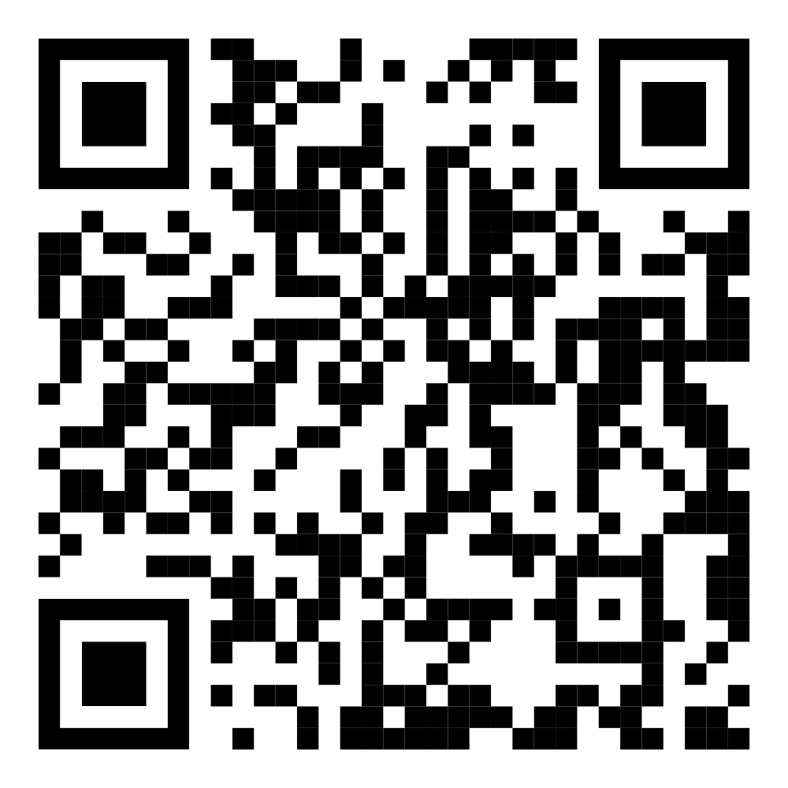
https://dmna.ny.gov/sapr/

